Slide 1
Loan Portfolio Management System
SQL Project
Reetu Tripathi

Slide 2
Introduction:-
Objective: Manage customers, loans, payments
Scope: Track active loans, overdue payments, interest earned

Slide 3
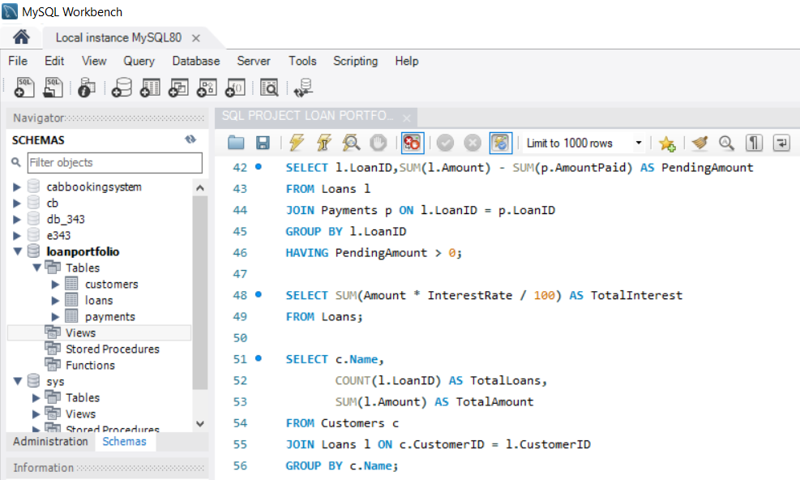
Database Schema:-
ER Diagram: Customers → Loans → Payments
Keys:
Customers → Primary Key: CustomerID
Loans → Primary Key: LoanID, Foreign Key: CustomerID
Payments → Primary Key: PaymentID, Foreign Key: LoanID
Relationship:
One Customer → Many Loans
One Loan → Many Payments
“Schema shows relationships between Customers, Loans, and Payments with proper primary and foreign keys.”

Slide 4
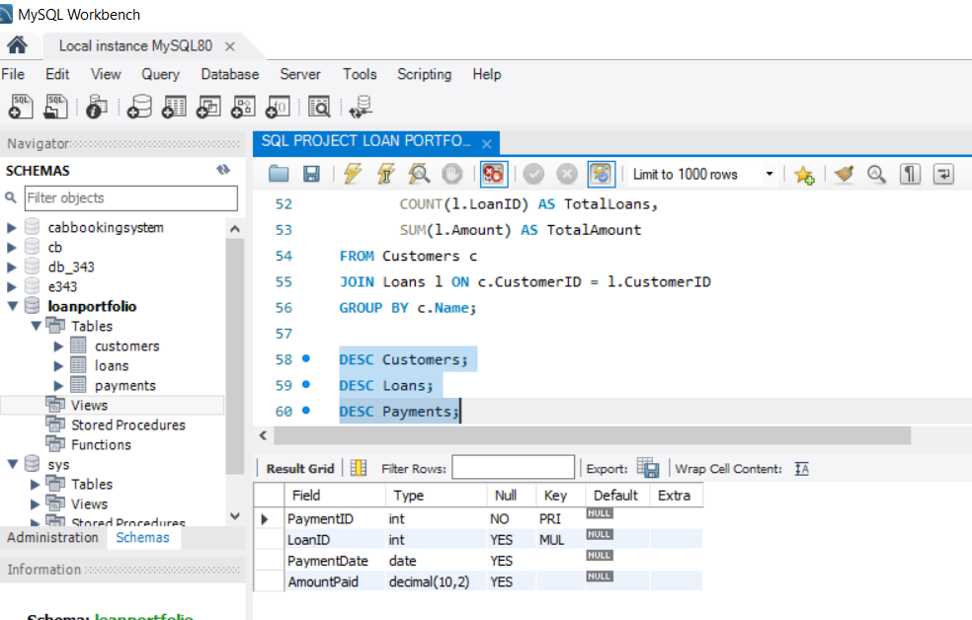
Tables:-
Customers Table → CustomerID (PK), Name, City, Contact
Loans Table → LoanID (PK), CustomerID (FK), LoanType, Amount, InterestRate, StartDate, EndDate
Payments Table → PaymentID (PK), LoanID (FK), PaymentDate, AmountPaid
Tables define the structure of loan portfolio data with proper primary and foreign keys.”

Slide 5
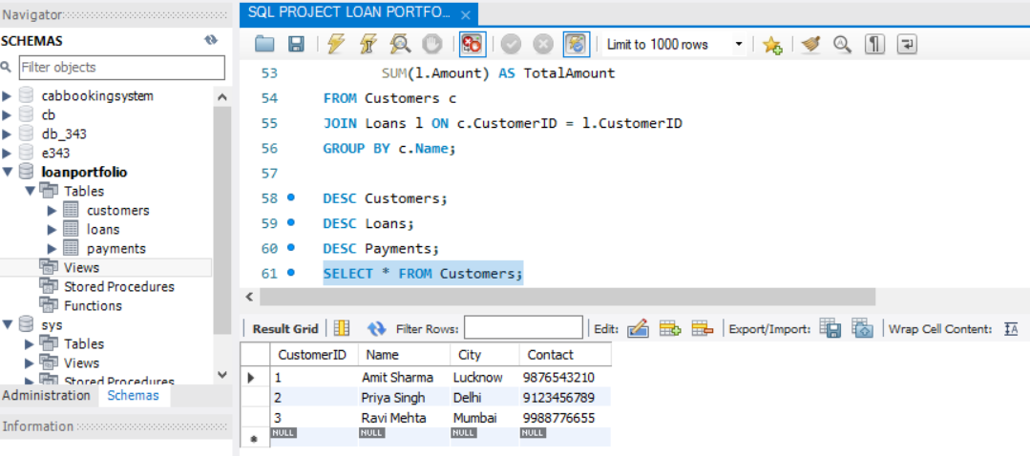
Sample Data:-
Customers Table: Sample client records inserted (Amit Sharma, Priya Singh, Ravi Mehta).
Loans Table: Loan details added for each customer (Business, Home, Personal loans).
Payments Table: Repayment records inserted showing partial payments.
Data inserted using INSERT INTO queries for testing and analysis.
"Sample data inserted for testing loan portfolio management."

Slide 6
Key Queries:
Active Loans: Query to list loans that are still ongoing.
Overdue Payments: Query to calculate pending loan amounts.
Total Interest Earned: Query to compute total interest from all loans.
Customer Loan Summary: Query to show each customer’s loan count and total loan amount.
-- Active Loans
SELECT LoanID, CustomerID, Amount, StartDate, EndDate
FROM Loans
WHERE EndDate > CURDATE();
-- Overdue Payments
SELECT l.LoanID, SUM(l.Amount) - SUM(p.AmountPaid) AS PendingAmount
FROM Loans l
JOIN Payments p ON l.LoanID = p.LoanID
GROUP BY l.LoanID
HAVING PendingAmount > 0;
-- Total Interest Earned
SELECT SUM(Amount * InterestRate / 100) AS TotalInterest
FROM Loans;
-- Customer Loan Summary
SELECT c.Name, COUNT(l.LoanID) AS TotalLoans, SUM(l.Amount) AS TotalAmount
FROM Customers c
JOIN Loans l ON c.CustomerID = l.CustomerID
GROUP BY c.Name;
Queries show active loans, pending balances, total interest, and customer summaries."

Slide 7
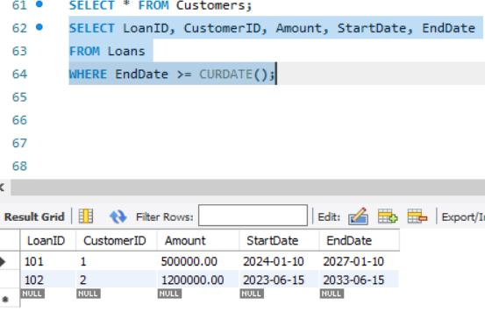
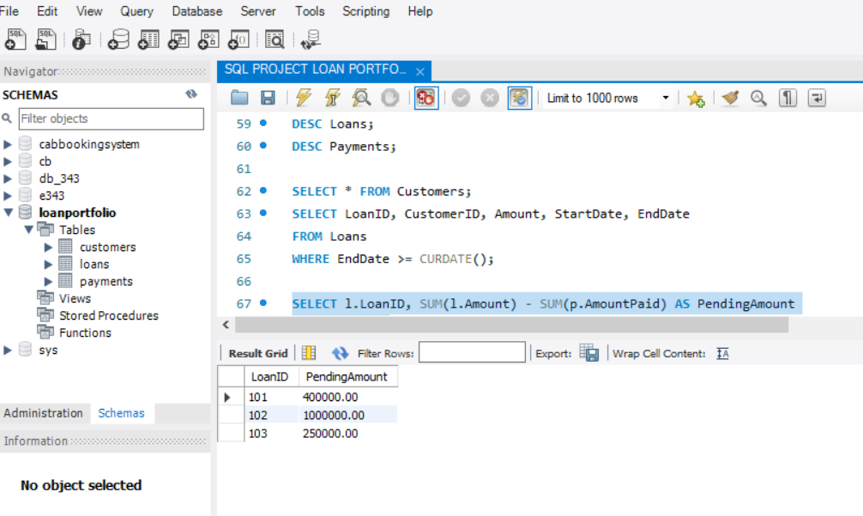
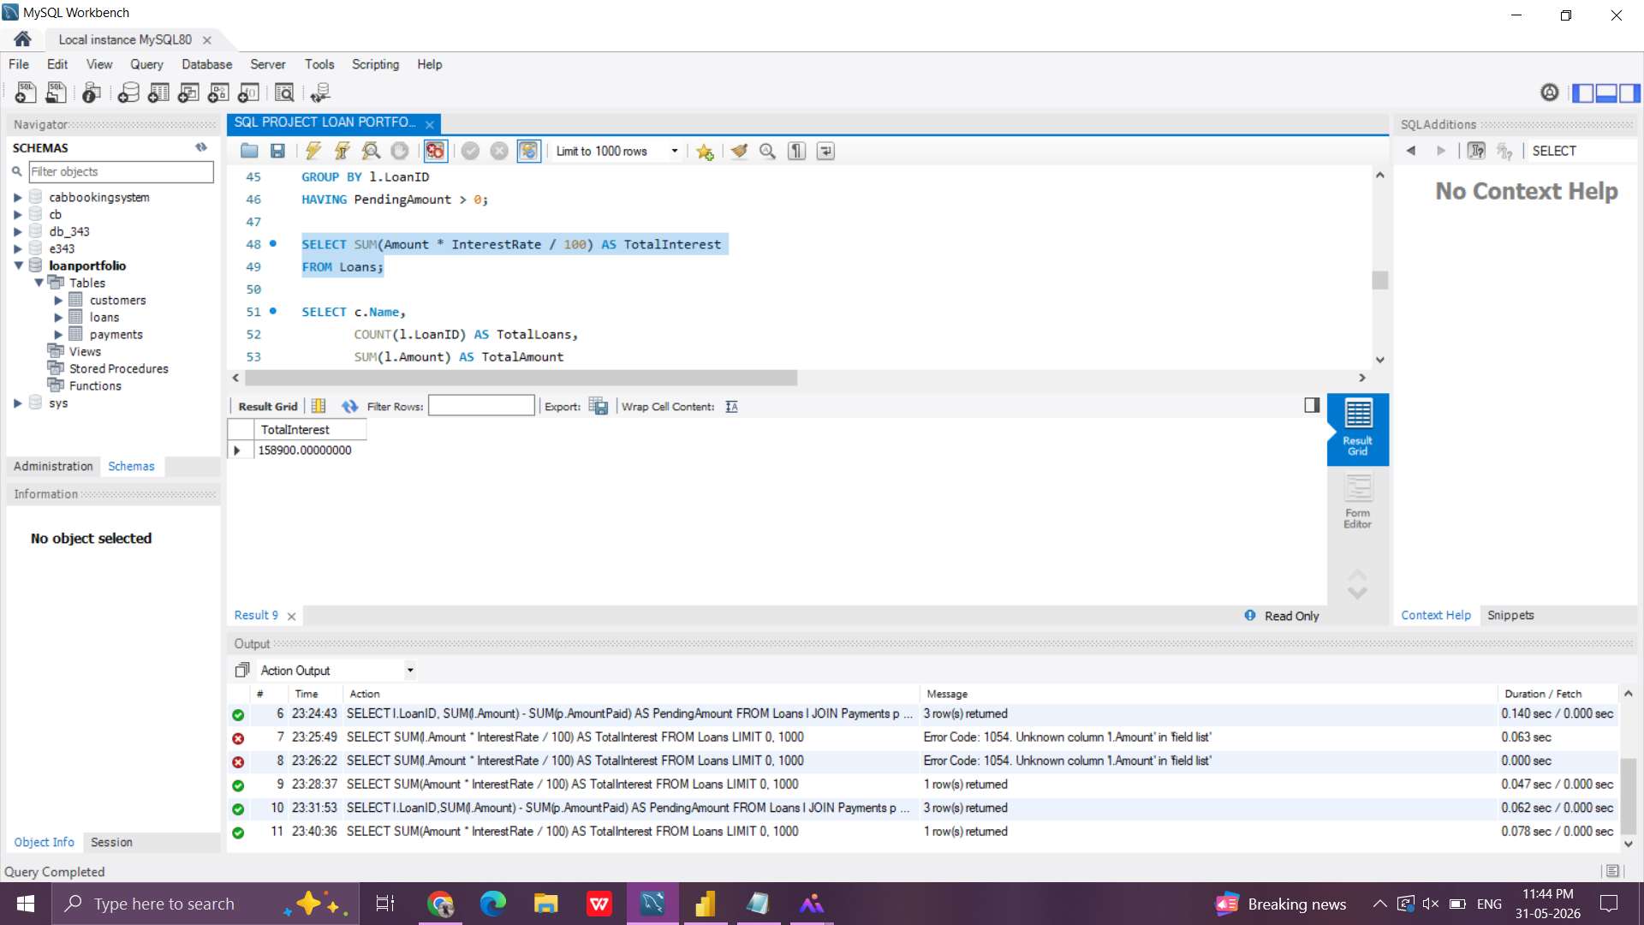
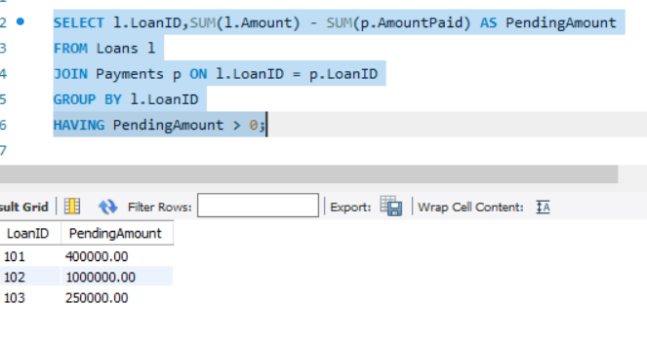
Query Results:-
Active Loans Result: Shows loans that are still ongoing based on EndDate.
Overdue Payments Result: Displays pending balances for loans where payments are incomplete.
Total Interest Result: Calculates overall interest earned from all loans.
Customer Loan Summary Result: Shows each customer’s loan count and total loan amount.
Query outputs provide insights into loan portfolio performance and customer activity.”

Slide 8
Insights:-
Active Loans Insight → Multiple ongoing loans show current exposure and portfolio size.
Overdue Payments Insight → Pending balances highlight repayment delays, indicating risk in recovery.
Total Interest Insight → Overall interest earned reflects profitability of the loan portfolio.
Customer Loan Summary Insight → Customer‑wise totals reveal concentration of loans among key clients, showing who contributes most to portfolio value.
Caption:
"Insights derived from query results help identify loan portfolio performance, repayment risks, and customer concentration."

Slide 9
Conclusion:-
Summary:
Project helps in loan tracking & repayment monitoring.
SQL queries provided a structured way to analyze loan portfolio data.
Key Insights:
Active Loans: Portfolio still has ongoing loans, showing current exposure.
Overdue Payments: Pending balances highlight repayment delays and risk areas.
Total Interest: Overall interest earned reflects profitability of the loan portfolio.
Customer Loan Summary: Customer‑wise totals reveal concentration of loans among key clients.
Future Scope:
Integration with dashboards for visual analysis.
Automation of loan tracking and repayment alerts.
Final Note:
"The project demonstrates how SQL can be applied to manage and analyze financial data effectively, supporting better decision‑making in loan portfolio management."

